Slide 1

Framing and Climate Change
Keywords:
Agenda-setting | Audiences | Perception
Local Actions

Slide 2
Framing Theory
The Frame
Agenda-setting theory
Main framing techniques:
- Metaphors
- Stories
- Tradition
- Slogan
- Artifacts
- Contrast
- Spins
Local Actions

Slide 3
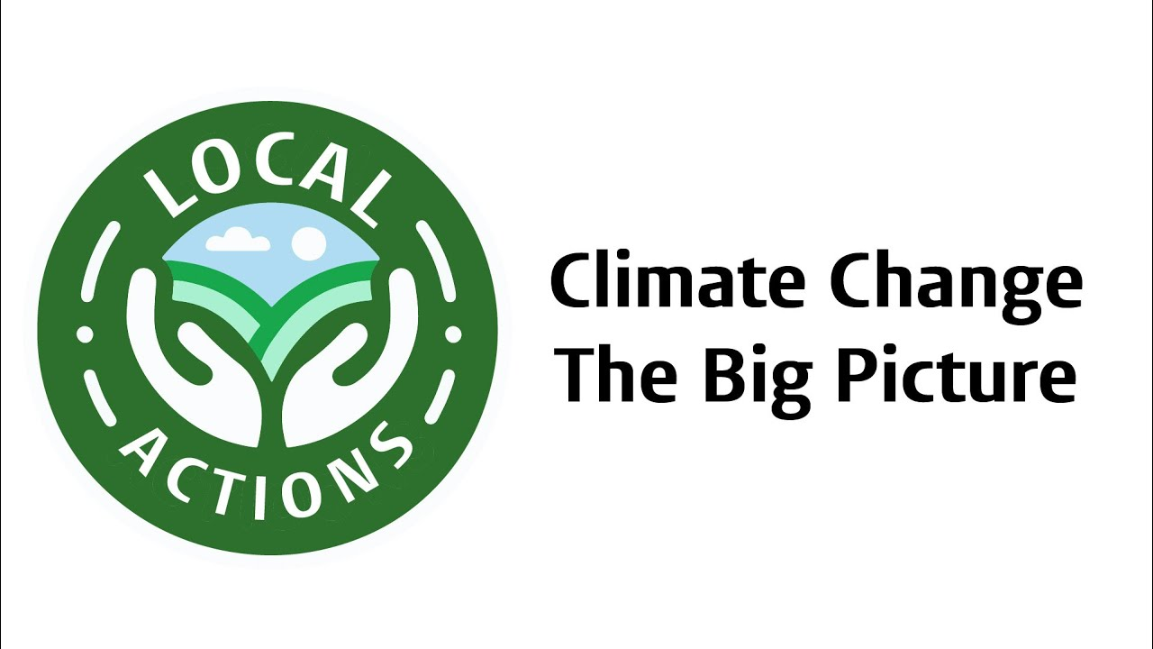
Climate Change
Long-term shifts in the typical weather patterns that characterise Earth’s local, regional, and global climates
Introductory Video
Local Actions

Slide 4
Connecting the Dots
Hope and Fear to frame Climate Change
Moving to “Change and progress”
Using mitigation frames
Local Actions

Slide 5
Local Action
Developing Climate Communication
You will think of contracting communication strategies for Climate Change
Go Online and find examples of traditional climate change communication. What are the frames?
What will your strategy be? Will you change your frame?
Discuss your strategy with classmates and finalize it
Create your approach and share it
Local Actions

